Slide 1
Packages

Slide 2
Package
A package is a set of related classes
Syntax to put a class into a package:
package <your.package.name>;
public class <ClassName> { …}
Two rules:
  A package declaration must always come first in your .java file
  Naming convention: all lower case, with ‘.’ separating nested package names, biggest package first.
Example:
package cis1068.au10.graphics;
public class Point3D { … }

Slide 3
Using packaged classes
Two options for using classes in a package:
1) Use full class name:
  <package.name>.<ClassName>
  For example,
  java.util.Scanner console
  = new java.util.Scanner(System.in);
2) Import the package, use the “qualified” name:
  At the top of the file, below any package declaration:
  import <package.name>.<ClassName>; or
  import <package.name>.*;
  Then you can use <ClassName> anywhere, without the full package name.
  For example,
  import java.util.Scanner; … (and later) …
  Scanner console = new Scanner(System.in);

Slide 4
Encapsulation

Slide 5
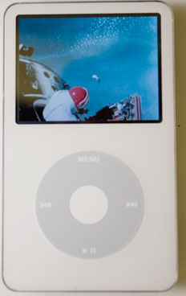
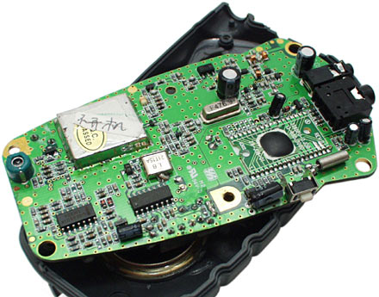
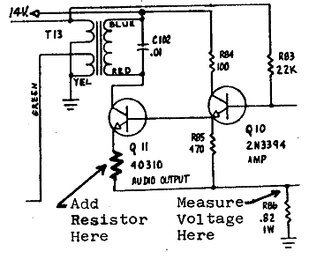
Encapsulation
encapsulation: Hiding the implementation details of an object from the clients of the object.
Encapsulating objects provides abstraction, because we can use them without knowing how they work.
?
?
?
?

Slide 6
Implementing encapsulation
Fields can be declared private to indicate that no code outside their own class can change them.
Declaring a private field, general syntax:
  private <type> <name>;
Examples:
  private int x;
  private String name;

Slide 7
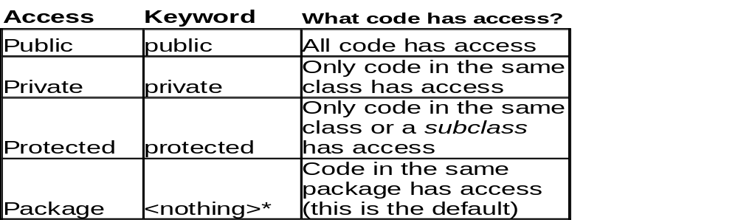
Access Specifiers
*Note: Package-level access is specified by leaving out any keyword. It is NOT specified using the package keyword, which is used for something else!

Slide 8
Private fields
Once fields are private, client code cannot directly access them. The client receives an error such as:
  PointMain3.java:8: x has private access in Point
  System.out.println("p1 is (" + p1.x + ", " + p1.y + ")");
How can the client program see what x is?

Slide 9
Accessors
accessor: An instance method that provides information about the state of an object.
Example:
  public int getX() {
  return x;
  }
This gives clients "read-only" access to the object's fields.

Slide 10
Mutators
mutator: An instance method that modifies the object’s internal state.
Example:
  public void setX(int newX) {
  x = newX;
  }

Slide 11
Mutable and Immutable objects
Definition: An immutable object is an object whose state cannot be modified after it is created.
The String class and all the wrapper classes are immutable in Java.
  As a result, we can’t use the wrapper classes to solve the swap problem for primitive types.
Point objects are mutable (ie, not immutable)
  setLocation and translate change their state
  We can use this fact to make the swap method work

Slide 12
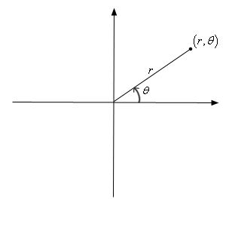
Benefits of encapsulation
Encapsulation helps provide a clean layer of abstraction between an object and its clients.
Encapsulation protects an object from unwanted access by clients.
  Would you like any program to be able to modify the BankAccount object with your account information?
Encapsulation allows the class author to change the internal representation later if necessary.
  Example: Changing the Point class to use polar
  coordinates (a radius r and an angle θ from the origin)‏
Notes:
Changing of internal representation does not affect external view of the object.

Slide 13
The keyword this

Slide 14
Point class constructor
What happens if the constructor has the following header?
public Point3D(int x, int y, int z)‏

Slide 15
Variable shadowing
shadowed variable: A field that is "covered up" by a local variable or parameter with the same name.
Normally, it is illegal to have two variables in the same scope with the same name, but in this case (fields and local variables) it is allowed. Why?
Otherwise, to avoid shadowing, we would always have to give the parameters different names:
public Point3D(int initialX, int initialY, int initialZ) {
x = initialX;
y = initialY;
z = initialZ;
}

Slide 16
Using the keyword this
The this keyword is a reference to the implicit parameter (the object on which an instance method is being called).
Usage of the this keyword, general syntax:
  To refer to a field:
  this.<field name>
  To refer to a method:
  this.<method name>(<parameters>);

Slide 17
It's like this and like that and like this and...
The this keyword lets us use the same names and avoid shadowing:
  public Point3D(int x, int y, int z) {
this.x = x;
this.y = y;
this.z = z;
}
When this. is present, the field is used.
When this. is not present, the parameter is used.

Slide 18
Wrapper Classes

Slide 19
Wrapper classes
Wrapper classes are object types that correspond to each primitive type
Two important methods in Wrapper classes:
  parseInt(String s) (or parseDouble, parseLong …)
  intValue() (or doubleValue(), longValue(), …)
Important fields: MAX_VALUE, MIN_VALUE
Primitive Type | Wrapper Class
int | Integer
long | Long
double | Double
boolean | Boolean
char | Character

Slide 20
Converting between primitive and Wrapper types
You can wrap a int in an Integer by assignment:
int x = 17;
Integer wrapX = new Integer(x);
Integer wrapX2 = x; // shorthand
To get an int value out of an Integer object:
Integer x = new Integer(17);
int unwrappedX = x.intValue();
int unwrappedX2 = x; // shorthand

Slide 21
Wrapper classes for swapping ints
  public static void main(String[] args) {
  Integer a = 7;
  Integer b = 35;
  System.out.println(a + " " + b);
  // swap a with b
  swap(a, b);
  System.out.println(a + " " + b);
  }
  public static void swap(Integer a, Integer b) {
  Integer temp = a;
  a = b;
  b = temp;
  }
What’s wrong with this version?

Slide 22
Madness to the method
The methods that appear to modify a string (substring, toLowerCase, toUpperCase, etc.) actually create and return a new string.
  String s = "lil bow wow";
  s.toUpperCase();
  System.out.println(s); // output: lil bow wow
  vs.
  String s = "lil bow wow";
  s = s.toUpperCase();
  System.out.println(s); // output: LIL BOW WOW

